Slide 1
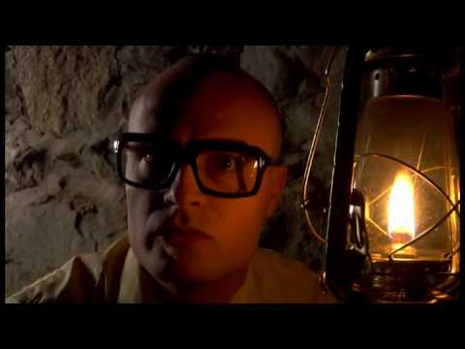
MC Frontalot - It Is Pitch Dark
Notes:
MC Frontalot - It Is Pitch Dark
https://www.youtube.com/watch?v=4nigRT2KmCE

Slide 2
Text Adventure Games
Daphne Ippolito
Chris Callison-Burch
http://interactive-fiction-class.org

Slide 3
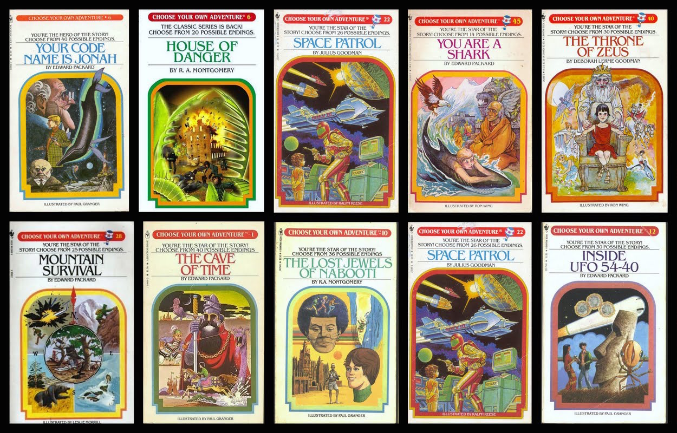
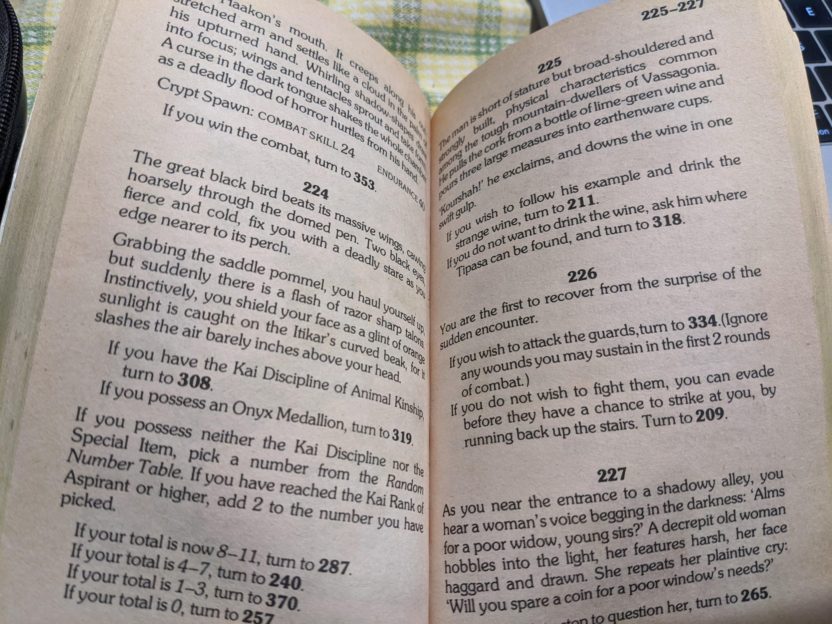
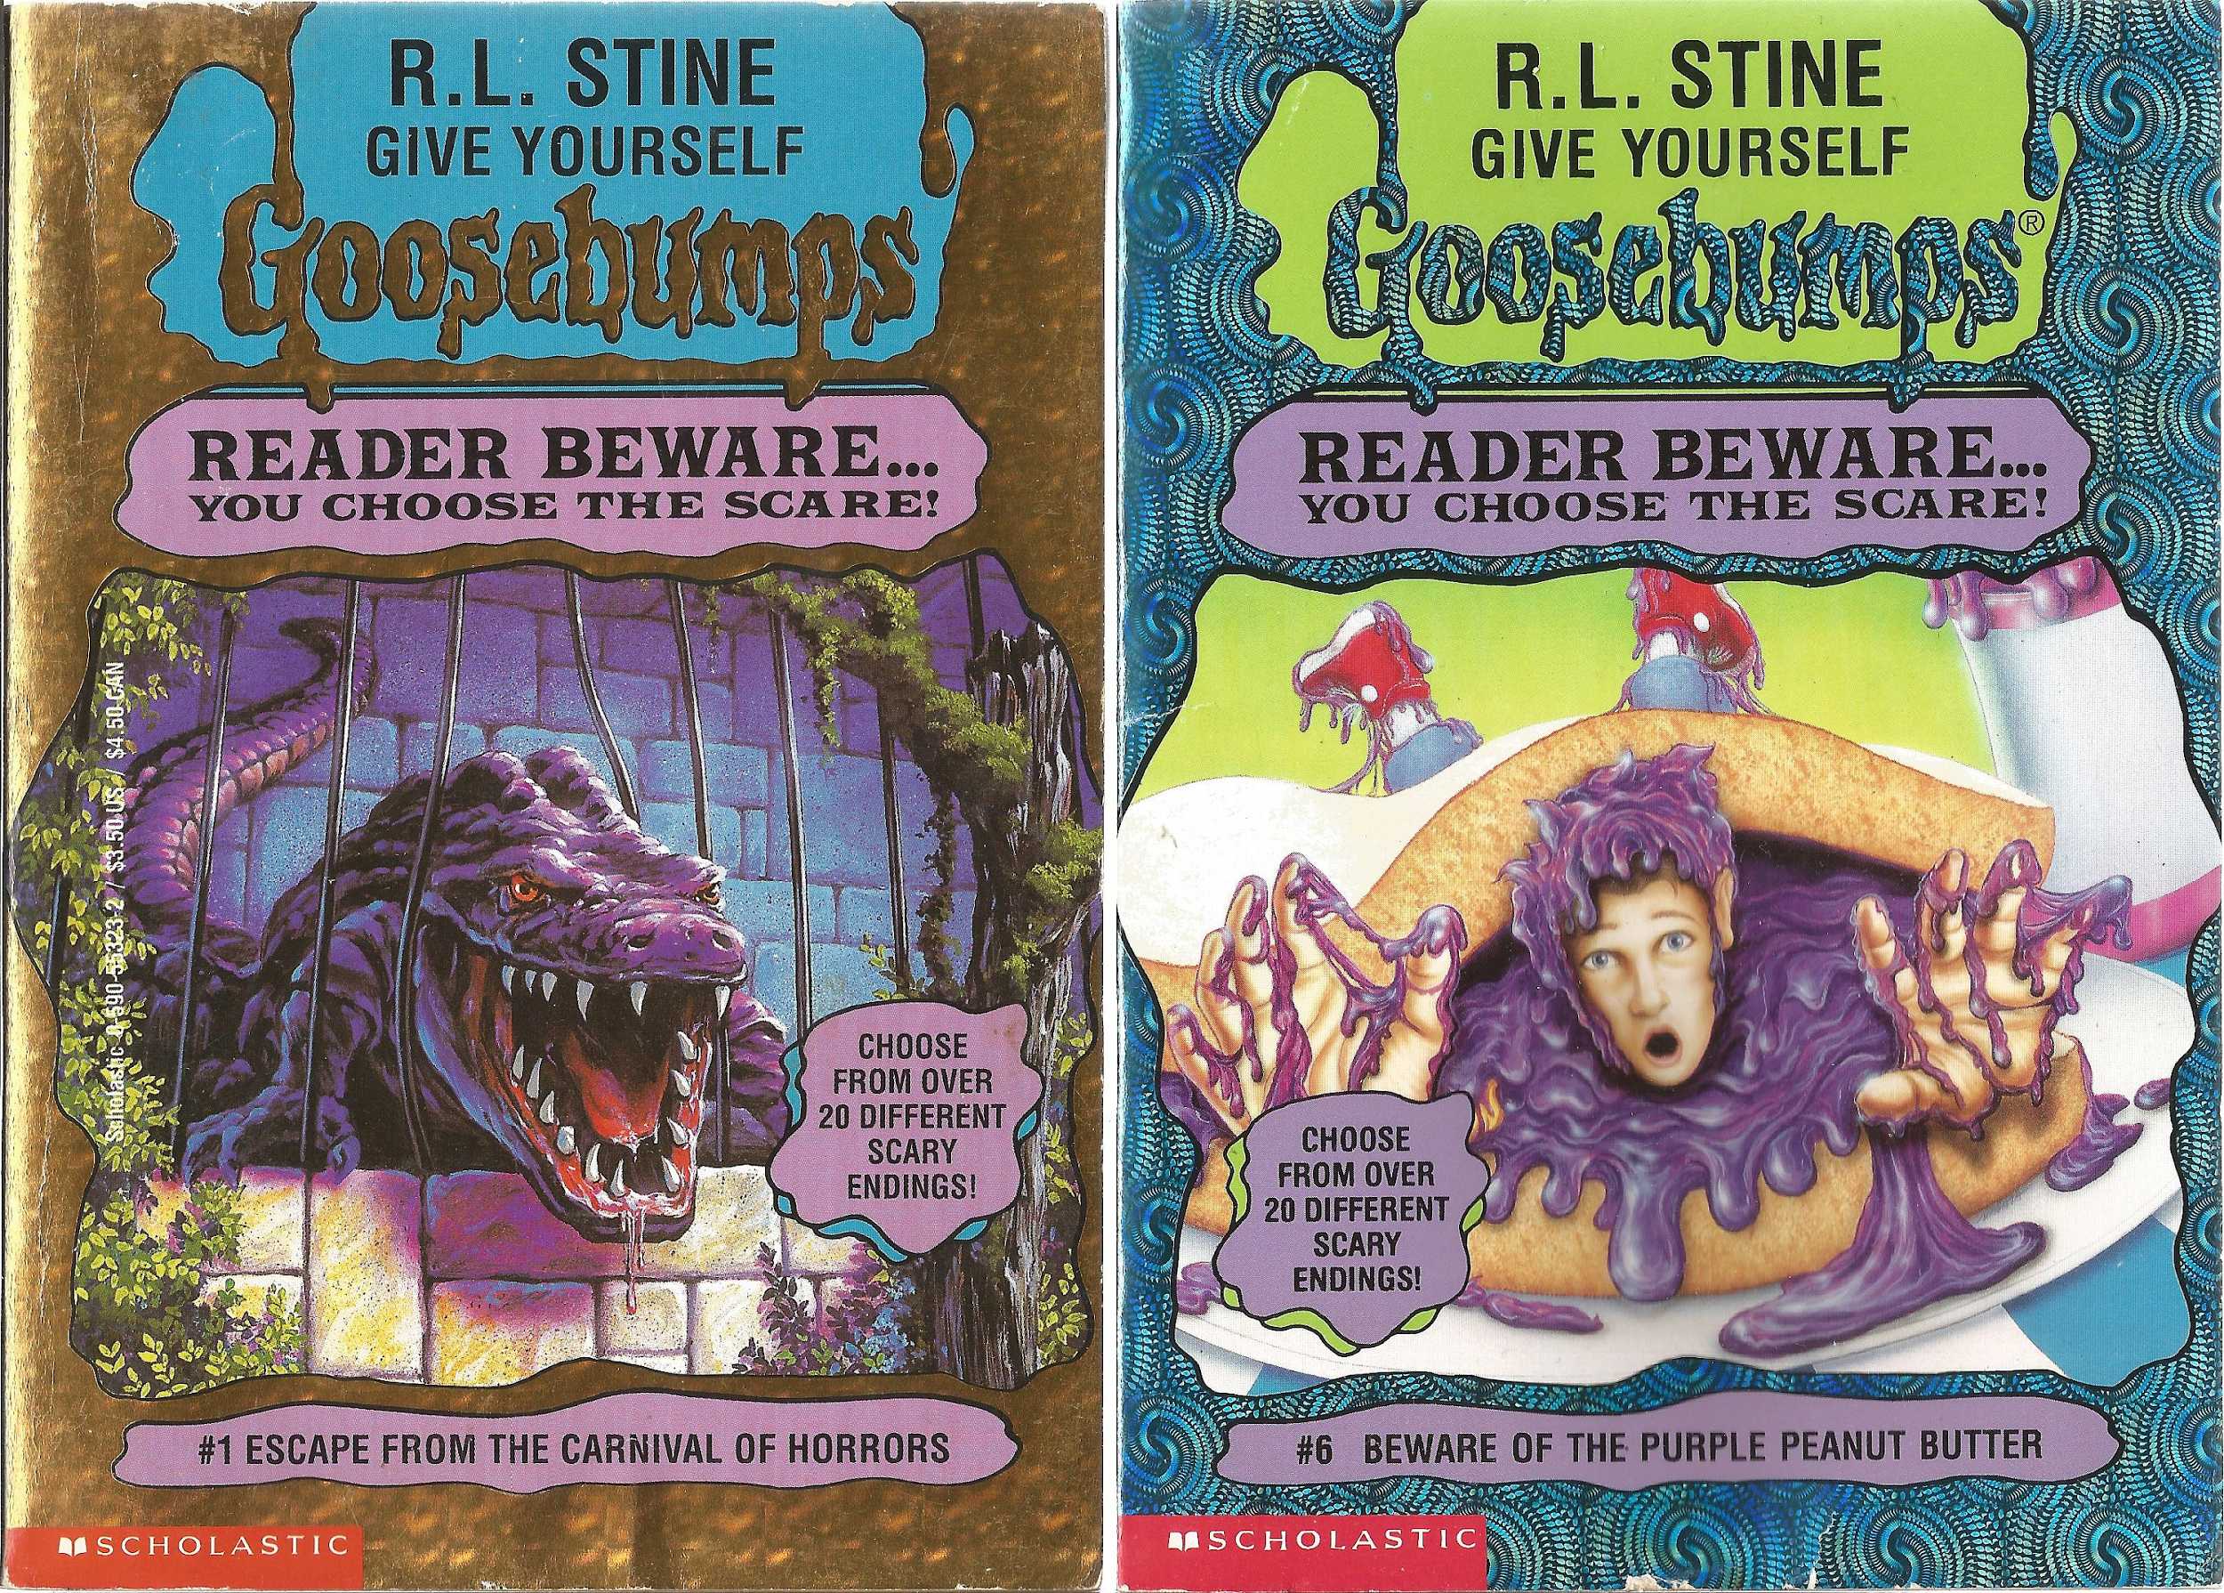
Paper Interactive Fiction
In the 1970s, “Choose your own adventure” books grew in popularity.
Notes:
If you possess the Onyx Medallion, turn to 319.

Slide 4
Notes:
From https://www.seanmichaelragan.com/html/[2008-03-07]_Choose_Your_Own_Adventure_book_as_directed_graph.shtml

Slide 5
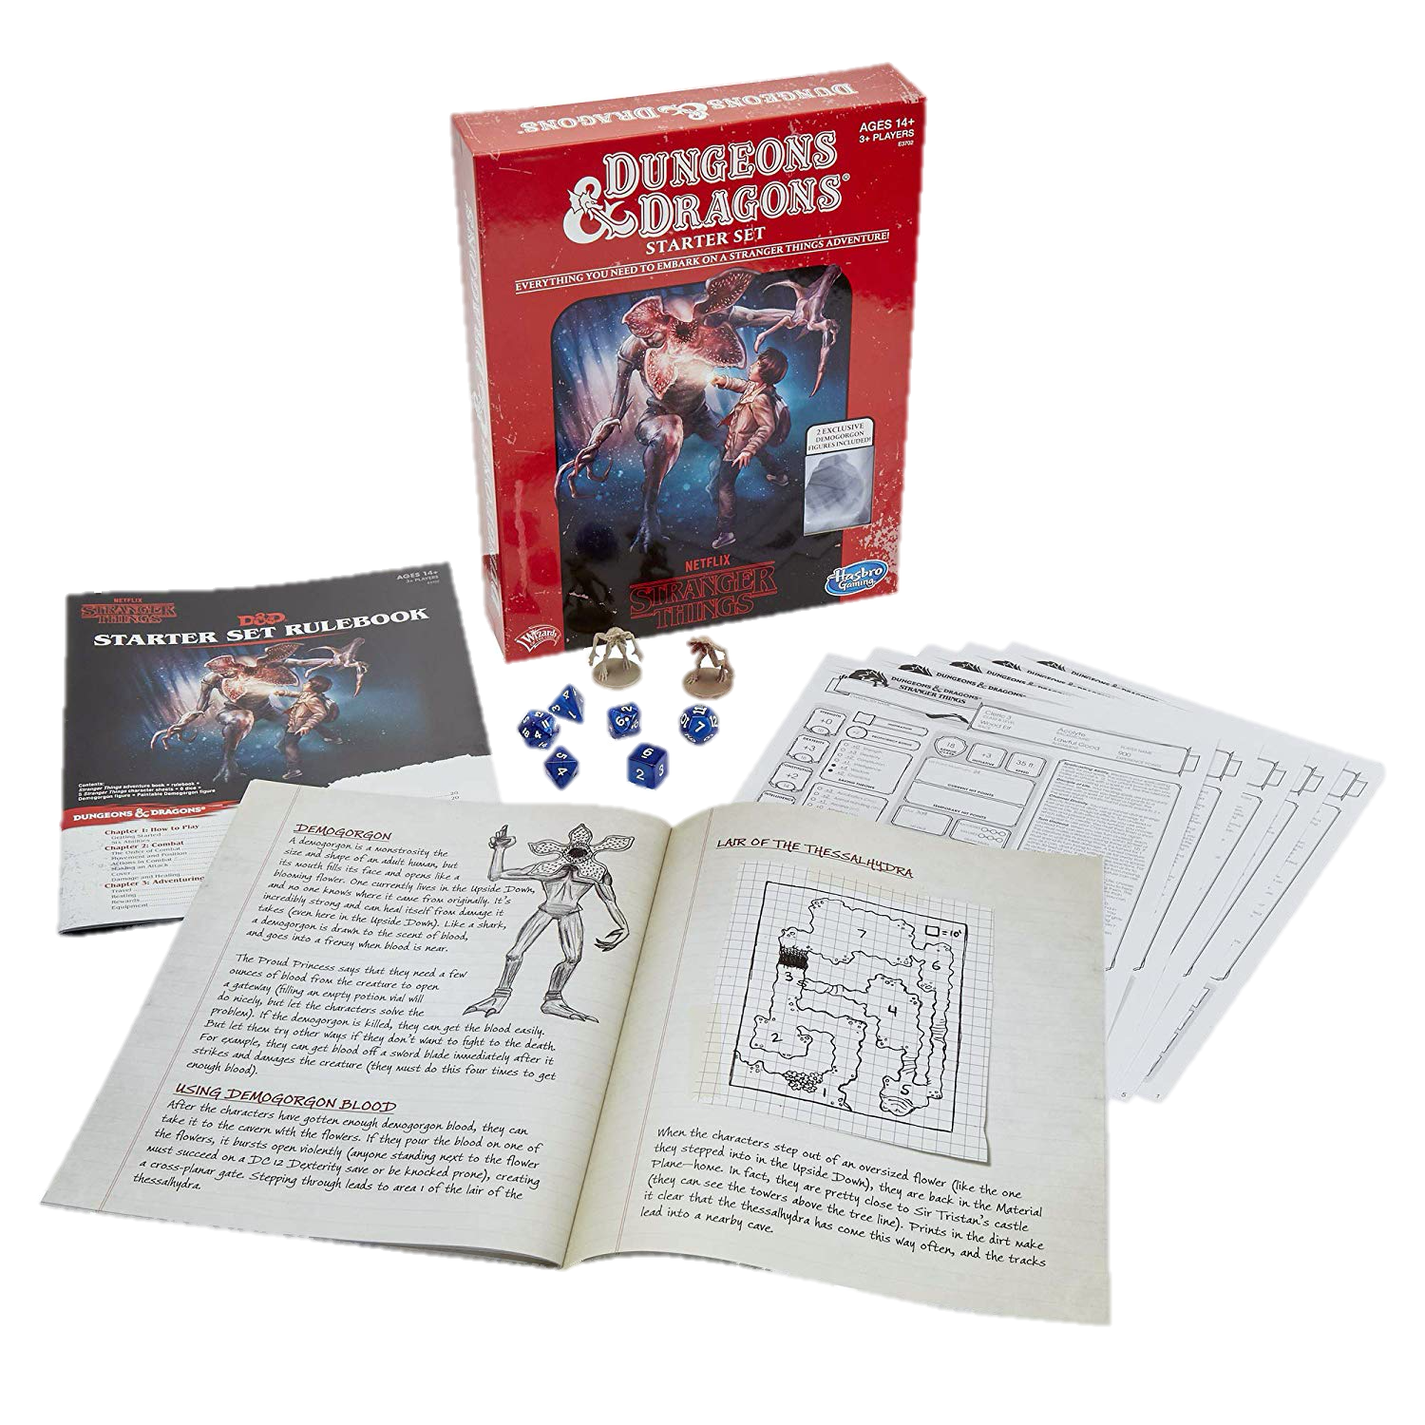
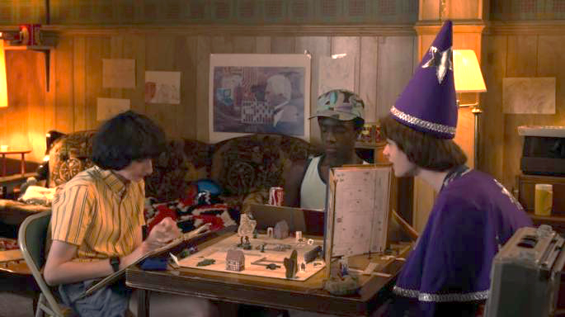
Paper & Pencil Interactive Fiction
Dungeons & Dragons is a fantasy tabletop role playing game first published in 1974.

Slide 6
Computer Games Before Graphics

Slide 7
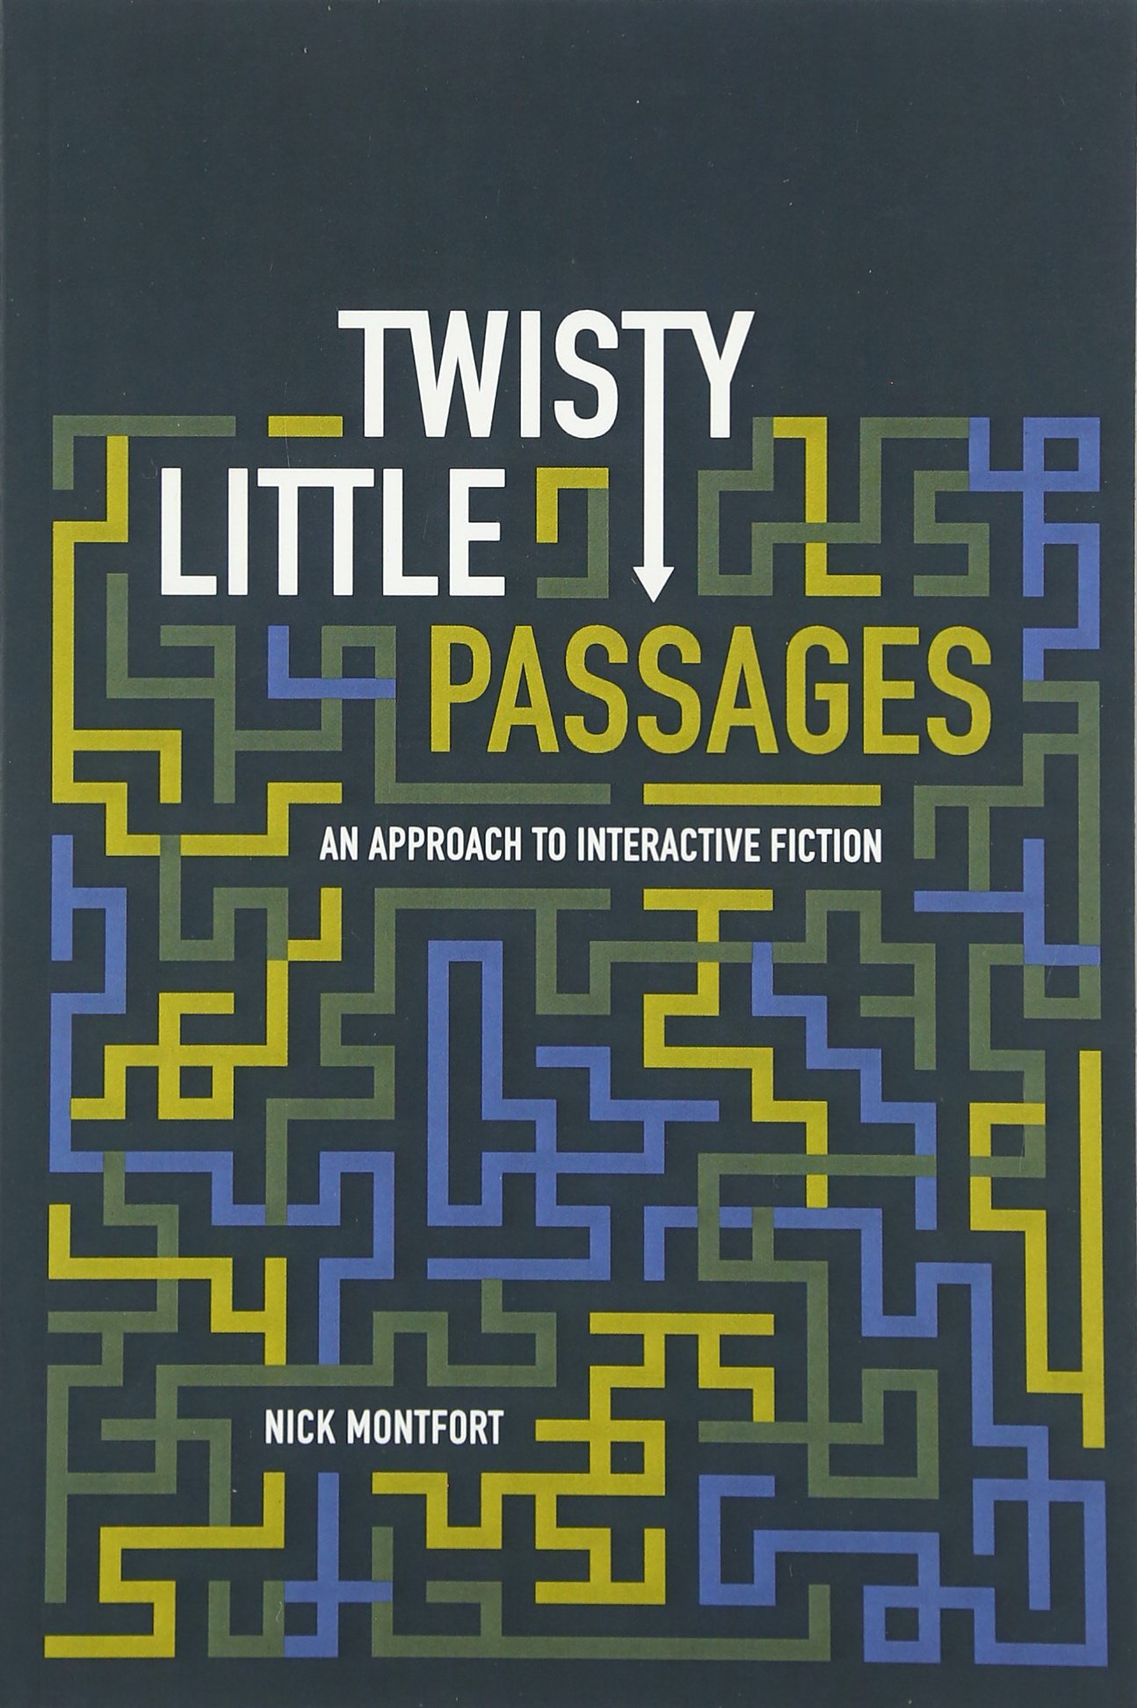
Interactive Fiction Games
The two essential components of interactive fiction are
The parser, which is the component that analyzes natural language input in an interactive fiction work.
The world model, which is setting of an interactive fiction work.
Notes:
The simulated world is represented computationally in some sort of data structure or collection of objects. It is this simulated world that distinguishes a work of interactive fiction from a conversational character or from an expert system that employs natural language understanding.

Slide 8
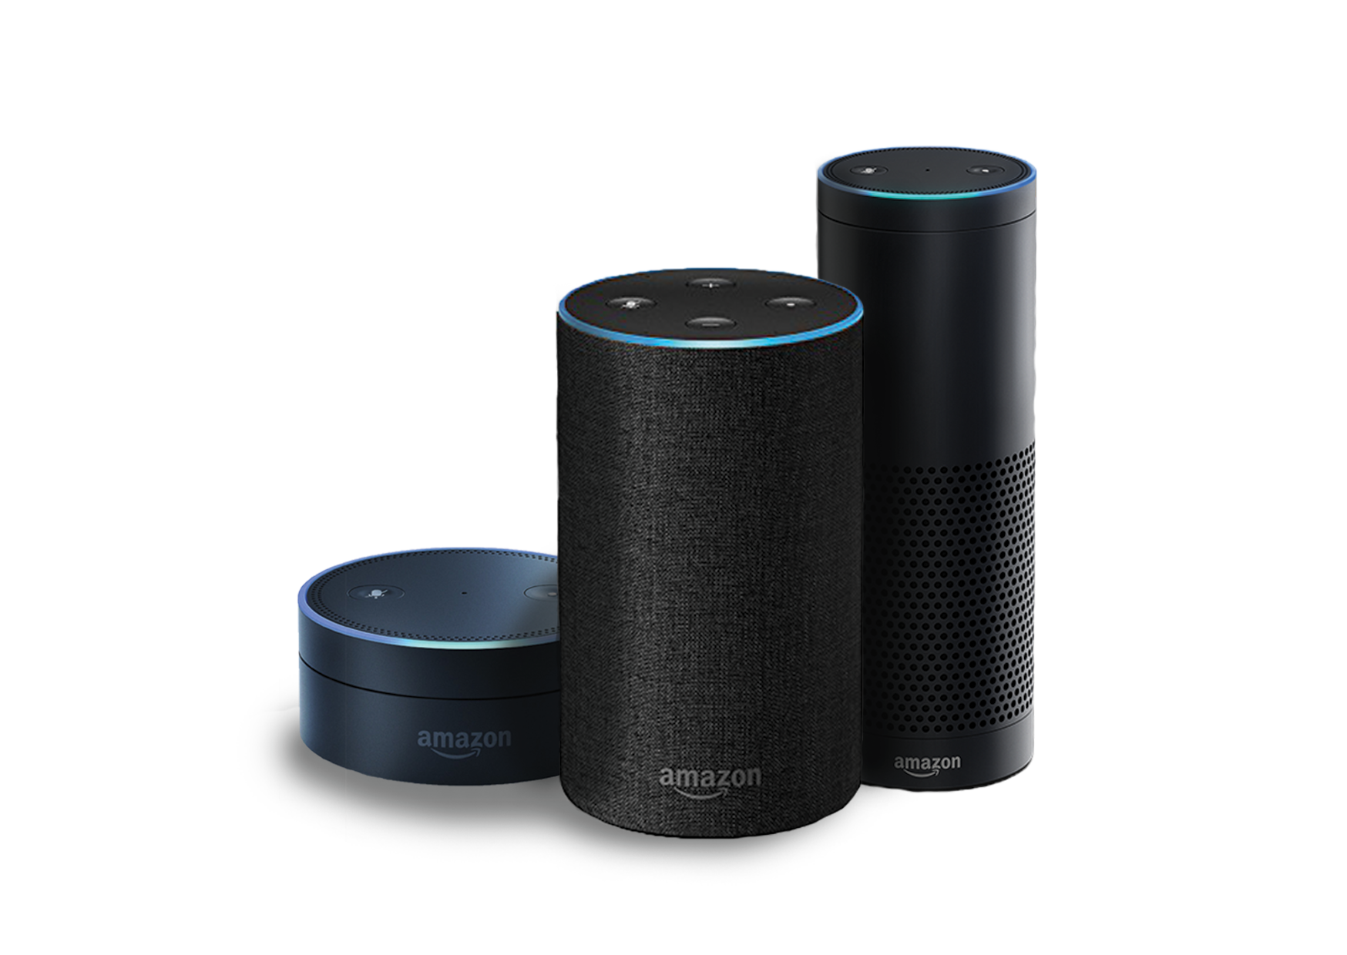

Natural Language Understanding
Will it rain tomorrow? Set an alarm for 6:30a.m. Play music from They Might Be Giants. How many pints are in a gallon? Add blueberries to my shopping list. When did California become a state? When is the Winter solstace? What is the weather like in Hawaii this weekend? Turn off the lights. Open the pod bay doors.

Slide 9
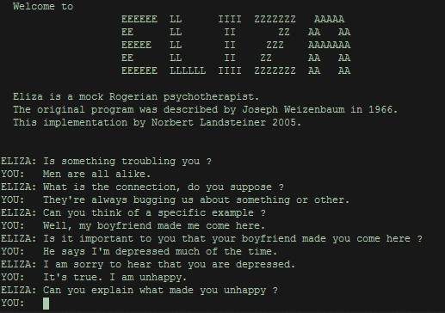
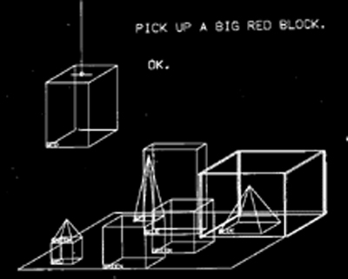
Natural Language Understanding

Slide 10
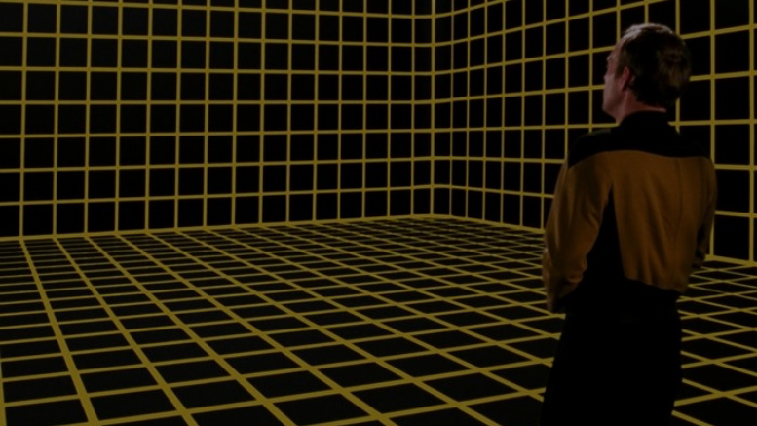
Simulated World
What’s the difference between a conversational agent and a work of interactive fiction? The simulated world.
It represents the physical environment, and things like • Settings or locations • Physical objects in each setting • The player’s character • Non-player characters It also represents and simulates the physical laws of the environment.
Notes:
The world model is typically implemented in the interactive fiction program as some type of graph or tree with associated procedures.

Slide 11
Locations

Slide 12
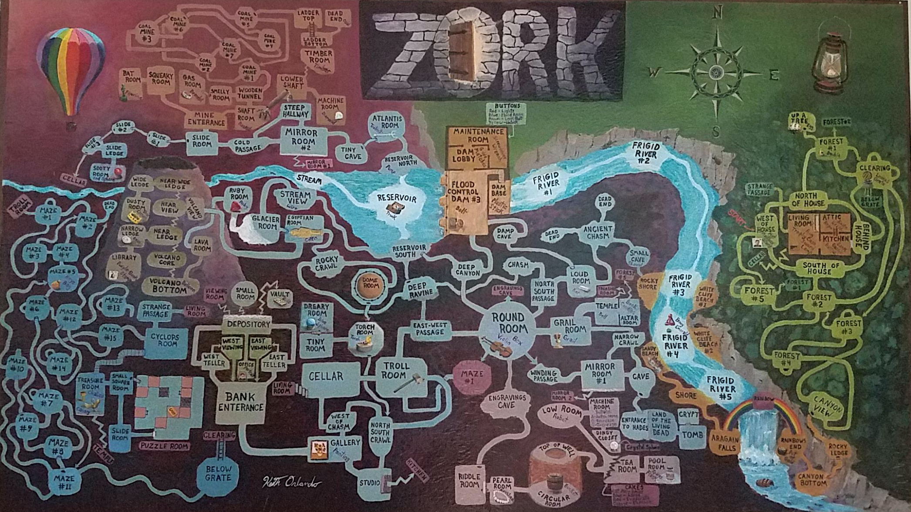
Notes:
Credit: Reddit user ion_bond Source URL: https://www.reddit.com/r/zork/comments/5ximil/zork_map_mit_version_fantastic_game_i_spent_some/

Slide 13
Objects

Slide 14
Verbs

Slide 15
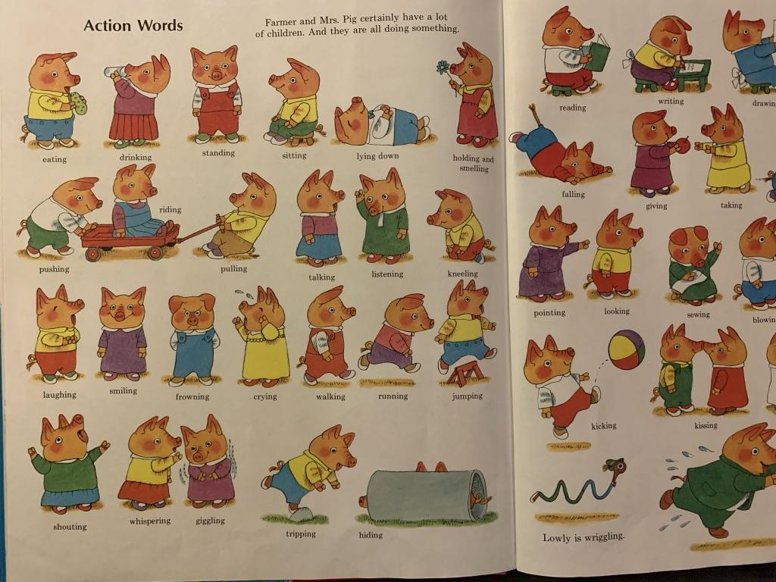
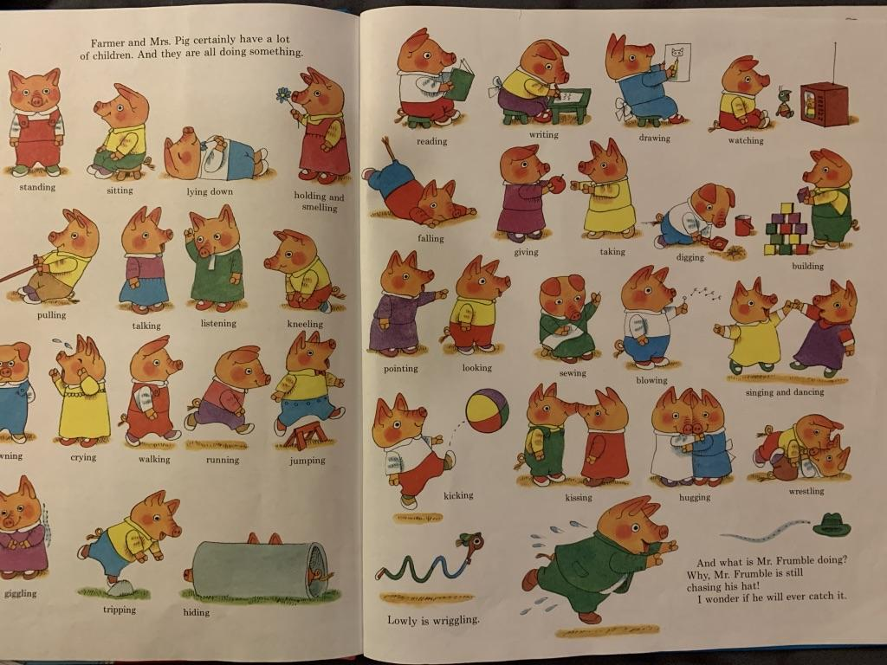
Notes:
Verbs

